Slide 1
Networking Review (Protocols)
UT CS361S – Network Security and Privacy
Fall 2021
Lecture Notes

Slide 2
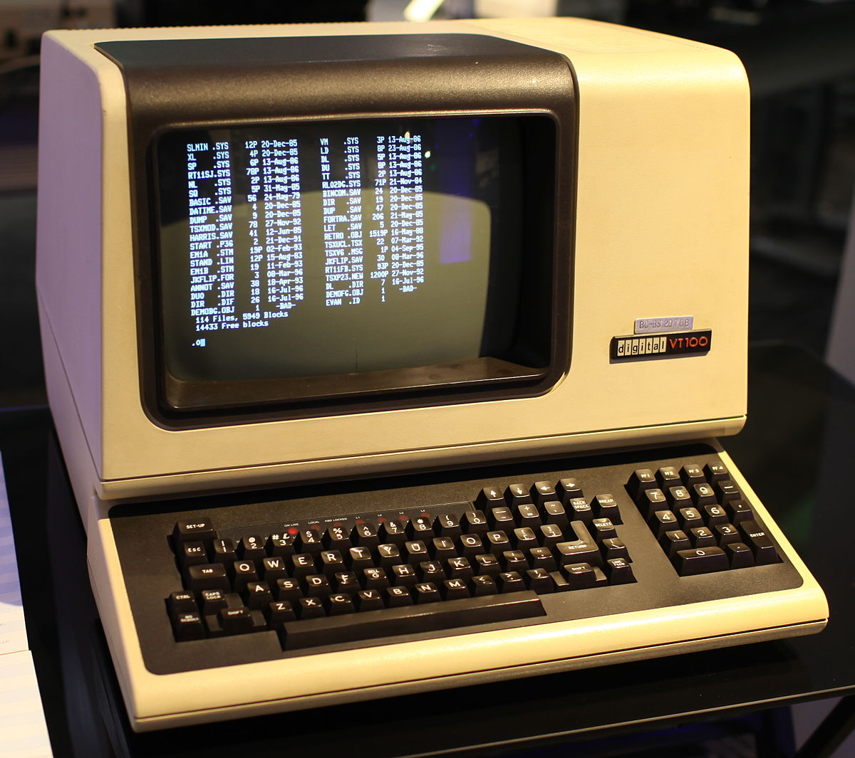

Computing 1960-1980 (ish)
NETWORK
This Photo by Unknown Author is licensed under CC BY-SA-NC
“DUMB” TERMINAL
MAINFRAME
This Photo by Unknown Author is licensed under CC BY-SA

Slide 3
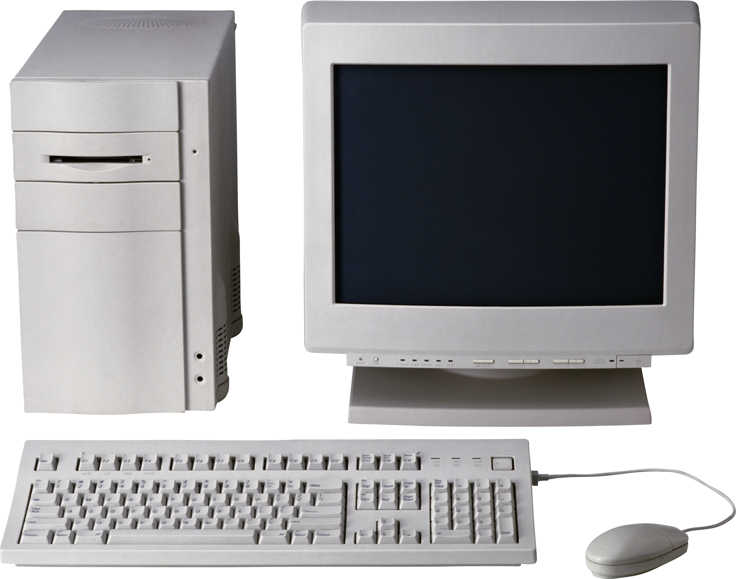
Computing 1980-2000 (ish)
This Photo by Unknown Author is licensed under CC BY-NC

Slide 4
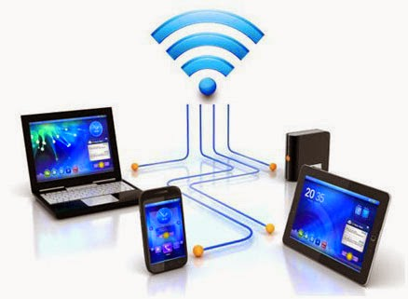

Computing 2000 – Present
NETWORK
This Photo by Unknown Author is licensed under CC BY
This Photo by Unknown Author is licensed under CC BY-NC-ND

Slide 5
Simplified Network Communication
Two participants; we will call each one a “node”
Data is transmitted between participants in packets (chunks)
Packet includes metadata, usually prepended as a header
Header includes sender’s address and receiver’s address
Receiver can “reply” to sender’s packets by reversing addresses

Slide 6
ADDRESS: A
ADDRESS: B
TO: B
FROM: A
{DATA}
TO: A
FROM: B
{DATA}

Slide 7
Also, Network Discovery
Many communication patterns require discovery
Either, the discovery of the existence of nodes
And/or discovery of how to communicate with a specific node

Slide 8
What is a Protocol?
The set of rules that govern the interaction of two or more parties
In networking, it defines how two nodes communicate
When
What (including message structure)
How
Certain outcomes are guaranteed when the rules are followed

Slide 9
Protocol Stacks
Object-oriented design!
Modularity
Abstraction
Information hiding
Protocols are designed in an object-oriented fashion
Protocols are combined to solve more complex problems
Each protocol should focus on one purpose/goal (High Cohesion)
Different component protocols can be swapped (Low coupling)
We call a group of protocols that work together a protocol stack
In networking, a network protocol stack or a network stack

Slide 10
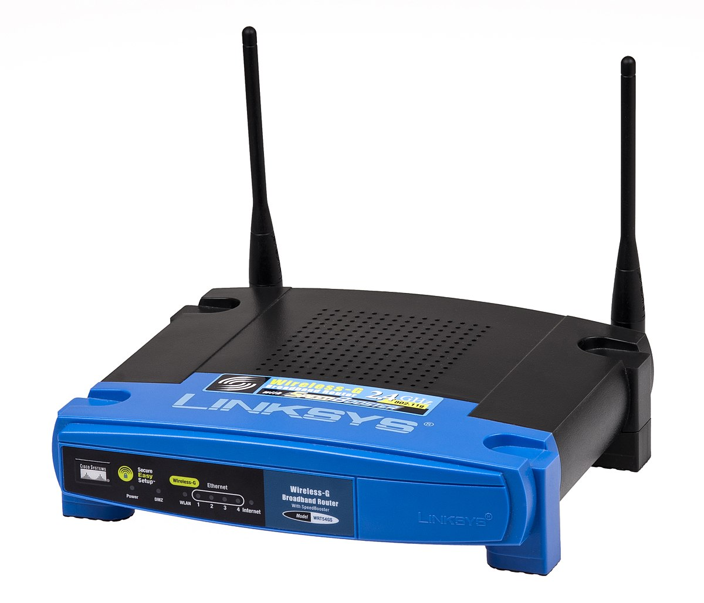
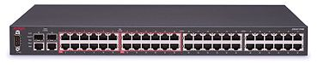
Monolithic vs Modular
HTTP Monolith Ethernet
HTTP Monolith
Wifi
HTTP
TCP
UDP
IP
Ethernet
WiFi
This Photo by Unknown Author is licensed under CC BY-SA
This Photo by Unknown Author is licensed under CC BY-SA

Slide 11
Other Problems with Monolithic
No separation of user/kernel space components
Code cannot be reused; code bloat
NxM combinations
Patching nightmare
Testing limitations
List goes on and on

Slide 12
OSI Model
Good object-oriented design is implementation independent
Conceptual guide for any given network stack implementation
It has seven layers:
7: Application
6: Presentation
5: Session
4: Transport
3: Network
2: Data Link
1: Physical

Slide 13
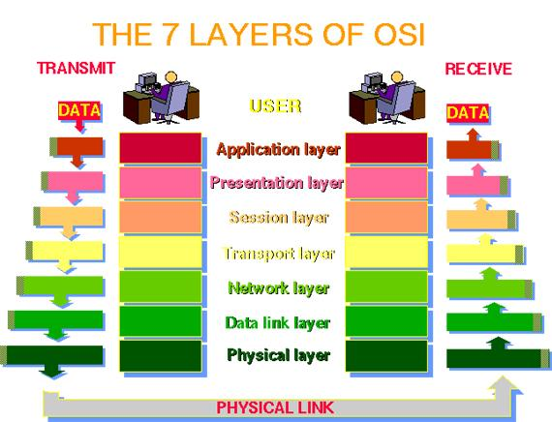

Slide 14
The OSI Model in Practice
Like most OO-designs, the abstraction often breaks down
The TCP/IP stack really only uses the following layers:
Application (Layer 7; example: HTTP)
Transport (Layer 4; TCP)
IP (Layer 3; IP)
Data Link (Layer 2; example: Ethernet)
Some breakdown in information hiding, abstractions, etc
NOTE: It’s common to just refer to a layer by it’s number (e.g., a layer-4 protocol)

Slide 15
TCP/IP Stack
For our purposes, we will focus on TCP/IP and TCP/IP-like stacks
The TCP and IP layers are fixed for layers 3 and 4 (hourglass)
But layers 7 and 2 vary widely
Millions of networked applications work over TCP/IP at layer 7
Many layer 2 protocols such as WiFi, Ethernet
Networked applications work over WiFi or Ethernet without any change
Sometimes called a MAC protocol (Media Access Protocol)
TCP/IP work over a walkie-talkie with an appropriate MAC protocol

Slide 16
How does Data Move in a Stack?
To send, data is inserted (pushed) at the top-most protocol
The receiving protocol
Processes the data, potentially splitting, recoding, etc
Derives one or more chunks of output data
Metadata added to each chunk (usually a header)
Each chunk, along with the meta-data is a “packet”
The packet is inserted (pushed) down to the next layer
On the receiving side, the process is reversed, starting at bottom

Slide 17
TCP/IP Stack Send Example
HTTP Request
TCP
TCP
HTTP Request
IP
IP
TCP
HTTP Request
MAC
MAC
IP
TCP
HTTP Request

Slide 18
Division of Labor in TCP/IP
At the MAC layer, protocol connects 2 endpoints. Typically:
Has its own addressing scheme (MAC address)
Controls who talks when
Provides error detection and error correction
IP (Internetwork Protocol)
Connects many different networks of different media types
Global addressing scheme
TCP
Reliable, in-order delivery (Session)
Multiplexing

Slide 19
Local Network Concepts
Local Area Network (LAN) – Direct node-to-node connection
Usually involves a “medium”, hence Medium Access Control
Nodes can send or receive MAC packets w/ MAC addresses
Broadcast typically used for discovery

Slide 20
“Old” Ethernet (< 10mbps)
Broadcast used for everything
Each node would only respond to packets addressed to it
Upon detecting a collision, node would randomly back-off

Slide 21
ADDRESS: C
Not for me!
ADDRESS: A
ADDRESS: B
BOADCAST
TO: B
FROM: A
{DATA}
ADDRESS: D
Not for me!

Slide 22
Modern Ethernet
Switches ensure the data is delivered to the right node
Broadcast (flooding) used to find a node the first time
Much more efficient; enables 100Mbs+

Slide 23
ADDRESS: C
ADDRESS: A
SWITCH
ADDRESS: B
TO: B
FROM: A
{DATA}
ADDRESS: D
Message from A on port 1. No idea where B is yet…

Slide 24
ADDRESS: C
ADDRESS: A
SWITCH
ADDRESS: B
TO: B
FROM: A
{DATA}
ADDRESS: D
Send message to all ports except port 1

Slide 25
ADDRESS: C
TO: A
FROM: B
{DATA}
ADDRESS: A
SWITCH
ADDRESS: B
ADDRESS: D
B is sending a message on port 3. I’ll remember that…

Slide 26
ADDRESS: C
TO: A
FROM: B
{DATA}
ADDRESS: A
SWITCH
ADDRESS: B
ADDRESS: D
Sending message to port 1, because that’s where A was last time

Slide 27
IP Address Mapping
MAC addresses are great, but app layer doesn’t use them
Even when communicating on your LAN, you use IP addrs
To communicate, IP-to-MAC address mapping required
Enter the Address Resolution Protocol (ARP)

Slide 28
ARP Broadcast Discovery
Every LAN has an explicit broadcast mechanism
Ethernet typically uses broadcast address FF:FF:FF:FF:FF:FF
When IP with unknown MAC mapping needed, broadcast
Ask all nodes on the LAN “who has IP addr X, tell IP addr W”

Slide 29
IP: Y
MAC: C
IP: W
MAC: A
IP: X
MAC: B
BOADCAST
TO: ALL
FROM: A
Who has IP X? Tell IP W
IP: Z
MAC: D
Hey, that’s me!

Slide 30
IP: Y
MAC: C
IP: W
MAC: A
IP: X
MAC: B
ARP Response
ARP TABLE:
IP X <-> MAC B
TO: A
FROM: B
I have IP X
IP: Z
MAC: D

Slide 31
IP to MAC conversion
Once ARP has the IP to MAC in the table, conversion is easy
Translation occurs in Ethernet layer during “push” from IP
IP destination addr is looked up in ARP table
PS, what “layer” in OSI is ARP?

Slide 32
Internetworking Concepts
We’ve covered how to talk to a LAN node.
What about a node outside our broadcast domain?
Requires internetwork routing

Slide 33
Exiting the LAN
A gateway node is connected to TWO+ LANs
For any external IP address, use the MAC addr of the gateway
(True dest IP addr remains the same!)
Gateway node will examine the dest IP addr
Gateway node determines where to send the data next

Slide 34
LAN 1 LAN 2
IP Packet
SRC: W
DST: M
IP Packet
SRC: W
DST: M
ARP TABLE:
GW <-> MAC B
ETHERNET PROTOCOL
ETHERNET PROTOCOL
ETHERNET PROTOCOL
ETHERNET
SRC: A, DST: B
ETHERNET
SRC: B, DST: C
ETHERNET
SRC: B, DST: C
SRC: W, DST: M
SRC: W, DST: M
SRC: W, DST: M
IP: W
MAC: A
(GW) IP: X
MAC: B
IP: M
MAC: C

Slide 35
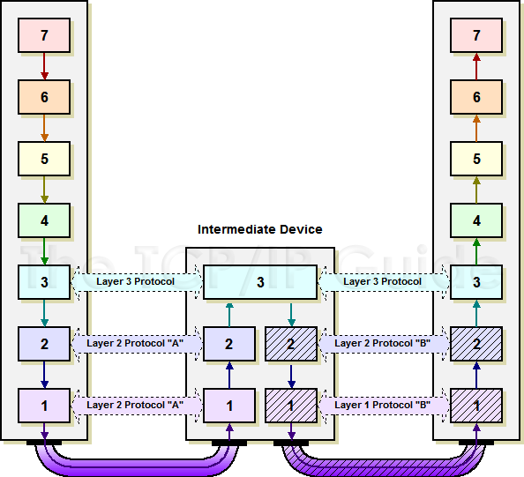
http://www.tcpipguide.com/free/t_IndirectDeviceConnectionandMessageRouting.htm

Slide 36
Routing Across the Internet
Data may have to move up a hierarchy
You to a Tier-3 ISP to a Tier-2 ISP, to a Tier 1 ISP
Top level ISP’s usually manage the “Autonomous Systems” (AS)
AS’s are the top level of the Internet in terms of routing
AS’s are interconnected and represent the “backbone”

Slide 37
Domain Name System (DNS)
We don’t usually browse the web with IP addresses
You can, of course. Try browsing to 172.217.13.4
But what a pain to remember
DNS is how we convert “google.com” to “172.217.13.4”

Slide 38
Client-Server Concepts
Put resources in a high-performance, centralized machine
Clients can be much “dumber” by comparison
Much more efficient
Sharing data between devices, applications, and people
Access from multiple locations (including hackers!)
Time-sharing a central machine is more scalable & cost-effective

Slide 39

Server Abstraction
I’m Lonely. I wish someone would talk to me!
This Photo by Unknown Author is licensed under CC BY-SA
SERVER LISTENS FOR INCOMING REQUESTS

Slide 40

Preview of TCP/IP
Now I have an Address/Port! Maybe I’ll get Requests!
IP: 192.168.0.1
PORT: 80
This Photo by Unknown Author is licensed under CC BY-NC
This Photo by Unknown Author is licensed under CC BY-SA
SERVER HAS AN IP ADDRESS AND TCP PORT

Slide 41

Meanwhile, Client Abstraction
HELLO?!
This Photo by Unknown Author is licensed under CC BY-NC
CLIENT CONNECTS TO MAKE OUTBOUND REQUESTS

Slide 42

TCP/IP Again
HELLO?!
TO: 192.168.0.1:80
FROM: 192.168.0.2:5280
Usually random
This Photo by Unknown Author is licensed under CC BY-NC
This Photo by Unknown Author is licensed under CC BY-NC
CLIENT CONNECTS TO MAKE OUTBOUND REQUESTS

Slide 43
Incoming Request
I GOT A REQUEST!!!
REQUEST
TO: 192.168.0.1:80
FROM: 192.168.0.2:5280
This Photo by Unknown Author is licensed under CC BY-SA
SERVER RECEIVES REQUEST

Slide 44
Request Response
MY NEW PENPAL!
RESPONSE
TO: 192.168.0.2:5280 FROM: 192.168.0.1:80
This Photo by Unknown Author is licensed under CC BY-SA
SERVER INVERTS TO/FROM FOR RESPONSE

Slide 45
Server Listens to Many Requests
SERVER USES (SRC IP, SRC PORT, DST IP, DST PORT)* TO MULTIPLEX
This is how one server on one port (e.g., webserver) handles many clients, even from the same computer
192.168.1.1, 5280, 192.168.1.2, 80 | Web Server Process 1
192.168.1.1, 9019, 192.168.1.2, 80 | Web Server Process 2

